Slide 1
Identification of Different Medicinal Plants/Raw materials through Image Processing Using Machine Learning Algorithms
PIP4004- UNIVERSITY PROJECT
Review-1
Batch Number: CIT-G18
STUDENT NAME | ROLL NUMBER
20211CIT0070 | NANDINI R
20211CIT0101 | REDDY SREYA
20211CIT0106 | CHANDANA K
20211CIT0153 | VINUTHA K
Under the Supervision of,
Dr. Anandaraj S P
Head Of Department CCS,CIT
School of Computer Science and Engineering
Presidency University
Name of the Program: CSE IOT
Name of the HoD: Dr. Anandaraj S P
Name of the Program Project Coordinator: Dr. Sharmasth Vali Y
Name of the School Project Coordinators: Dr. Sampath A K / Dr. Abdul Khadar A / Mr. Md Ziaur Rahman

Slide 2
Introduction
Medicinal plants play a crucial role in traditional and modern medicine. Identifying these plants accurately is essential for their effective use in healthcare and pharmaceuticals.
However, manual identification is often time-consuming and error-prone. This project leverages image processing techniques combined with machine learning algorithms to automate and enhance the accuracy of medicinal plant identification.
By utilizing advanced pattern recognition and classification models, this approach aims to facilitate efficient plant recognition, benefiting researchers, herbalists, and pharmaceutical industries.
The integration of image processing with machine learning enables the extraction of key features such as leaf shape, texture, and color for precise identification
By developing a robust model trained on diverse datasets, this project aims to provide a reliable solution for recognizing medicinal plants and raw materials with high accuracy.

Slide 3
Literature Review
SL.NO | TITLE | AUTHOR | YEAR | ALGORITHM | DRAWBACKS
1 | Deep learning for medicinal plant species classification and recognition: a systematic review | Durga Prasad Sharma | 2024 | Convolutional Neural Networks (CNNs) ResNet, VGGNet, MobileNet Transfer Learning Models | Limited availability of high-quality labeled datasets Deep learning models require high computational resources Performance degrades with noisy or low-resolution images
2 | Medicinal Plant Identification in Real-Time Using Deep Learning Model | S. Kavitha | 2024 | CNN (VGG-16, ResNet-50) YOLO (You Only Look Once) for real-time detection | Training deep models requires a large dataset for high accuracy Struggles with overlapping or occluded leaves Cannot handle real-world environmental variations effectively
3 | Automated Identification of Medicinal Plants Using Machine Learning | N. V. Shrivathsa | 2024 | Support Vector Machine (SVM) K-Nearest Neighbors (KNN) Decision Trees CNN | SVM and KNN perform poorly with complex plant variations Feature extraction methods require manual tuning Deep learning models outperform traditional machine learning models
4 | CNN-Based Medicinal Plant Identification and Classification Using Optimized SVM | Himanshu Kumar Diwedi | 2024 | CNN + SVM (Hybrid Model) | Hybrid models increase computational complexity CNN models require a high volume of training images Difficult to fine-tune SVM hyperparameters
5 | Survey and Analysis of Medicinal Plant Identification via Image Processing and Machine Learning Techniques | Diksha Nimgade | 2023 | Region-Based CNN (R-CNN) Faster R-CNN GoogLeNet | R-CNN requires longer training time Difficulty in detecting plants in dense forests or mixed backgrounds Overfitting risk when dataset size is small

Slide 4
Literature Review
6 | Automated Real-Time Identification of Medicinal Plant Species in Natural Environment Using Deep Learning Models | Nithya M | 2023 | CNN (AlexNet, ResNet) YOLO for real-time detection | Real-time implementation is computationally expensive Struggles with environmental lighting conditions Difficulty in handling similar-looking plant species
7 | Medicinal Plant Detection Using Image Processing | M P Ashwin | 2024 | Image segmentation using K-Means clustering Feature extraction using Histogram of Oriented Gradients (HOG) Classification using Random Forest and SVM | Segmentation struggles with complex backgrounds K-Means clustering is sensitive to noise Random Forest requires extensive hyperparameter tuning
8 | A Systematic Review of Medicinal Plant Identification Using Deep Learning | Cesar Sanin | 2024 | CNN-based deep learning models Data augmentation techniques | Requires large and diverse datasets Generalization issues for unseen plant species Overfitting due to a lack of diverse training samples
9 | An AI-Based Approach for Medicinal Plant Identification Using Transfer Learning | Avat Daryab | 2023 | Transfer Learning (ResNet-50, VGG-19, MobileNet) | Performance highly dependent on pre-trained models Transfer learning may not generalize well for all medicinal plants Needs domain adaptation to perform better in different environmental conditions
10 | IndoHerb: Indonesia Medicinal Plants Recognition Using Transfer Learning and Deep Learning | Novanto Yudistira | 2024 | This research addresses the task of classifying Indonesian herbal plants through the implementation of transfer learning of Convolutional Neural Networks (CNN). To support our study, we curated an extensive dataset of herbal plant images from Indonesia with careful manual selection. Subsequently, we conducted rigorous data preprocessing, and classification utilizing transfer learning methodologies with five distinct models: ResNet, DenseNet, VGG, ConvNeXt, and Swin Transformer. | One major limitation is dataset diversity, as even with careful manual selection, the dataset may not fully capture the variations in plant appearance due to seasonal changes, different growth stages, or environmental factors.

Slide 5
Existing method Drawback
Manual Identification:
Requires expert knowledge, limiting accessibility.
Time-consuming and labor-intensive.
Prone to human errors and inconsistencies.
Traditional Image-Based Classification:
Struggles with complex plant structures and overlapping features.
Limited accuracy due to variations in lighting, background, and image quality.
Chemical Analysis & DNA Barcoding:
Expensive and requires specialized equipment.
Not feasible for large-scale real-time applications.
Mobile Apps with Rule-Based Systems:
Limited database coverage, leading to misclassification.
Cannot adapt to new plant species or environmental variations.

Slide 6
Proposed Method
The proposed method integrates image processing and machine learning to automate the identification of medicinal plants accurately.
1. Image Acquisition
Collect plant images using a camera/smartphone or from an existing dataset.
2. Image Preprocessing
Resize and enhance images by reducing noise and adjusting contrast.
Convert images into a standard format for feature extraction.
3. Feature Extraction
Identify key plant characteristics like:
Leaf shape (contour analysis)
Texture (pattern recognition)
Color (RGB/HSV values)

Slide 7
Proposed objective
4. Machine Learning Model
Train a Convolutional Neural Network (CNN) for classification.
Compare accuracy with models like SVM and Random Forest.
5. Classification & Identification
Input plant images into the trained model.
The model predicts the plant species based on extracted features.
6. Deployment & Application
Integrate the trained model into a mobile/web application.
Allow users to upload images and receive instant plant identification

Slide 8
Objectives
The objective of this project is to develop an automated system for identifying medicinal plants and raw materials using image processing and machine learning. The system aims to enhance accuracy by extracting key plant features such as leaf shape, texture, and color while reducing human dependency to minimize errors. It will be designed to be scalable and efficient, capable of recognizing a wide range of medicinal plants in real-time. Additionally, machine learning algorithms will be integrated to continuously improve the model’s adaptability, making it useful for researchers, herbalists, and the pharmaceutical industry.

Slide 9
Methodology/Modules
Image Acquisition:
Collect high-resolution images from diverse sources (cameras, online datasets, field studies).
Ensure images cover various lighting conditions, angles, and backgrounds for robust model training.
Preprocessing:
Convert images to a uniform format and size.
Apply noise reduction techniques (Gaussian filtering, median filtering).
Enhance contrast using histogram equalization.
Perform background removal and segmentation for clearer feature extraction.
Feature Extraction:
Utilize advanced image processing techniques:
Color Features: RGB, HSV, color histograms.
Texture Features: GLCM (Gray-Level Co-occurrence Matrix), Local Binary Patterns (LBP).
Shape Features: Contour analysis, edge detection (Canny, Sobel filters).
Apply Principal Component Analysis (PCA) for dimensionality reduction and improved efficiency.

Slide 10
Methodology/Modules
4.Machine Learning Model Training:
Train models using deep learning architectures (CNNs, ResNet, VGG16) for superior accuracy.
Implement classical ML models like SVM and Random Forest for comparison.
Optimize hyperparameters using Grid Search or Bayesian Optimization.
Use data augmentation techniques to increase dataset size and diversity.
5.Classification & Prediction:
Apply trained models to classify plant species with high confidence.
Implement an ensemble learning approach for improved accuracy.
Evaluate models using metrics like accuracy, precision, recall, and F1-score.
6.Output & Application:
Display classified plant names along with medicinal properties and uses.
Develop a user-friendly interface for farmers, researchers, and healthcare professionals.
Integrate results with mobile apps or web platforms for real-time plant identification.
Enable API integration for further applications in agriculture and pharmaceuticals

Slide 11
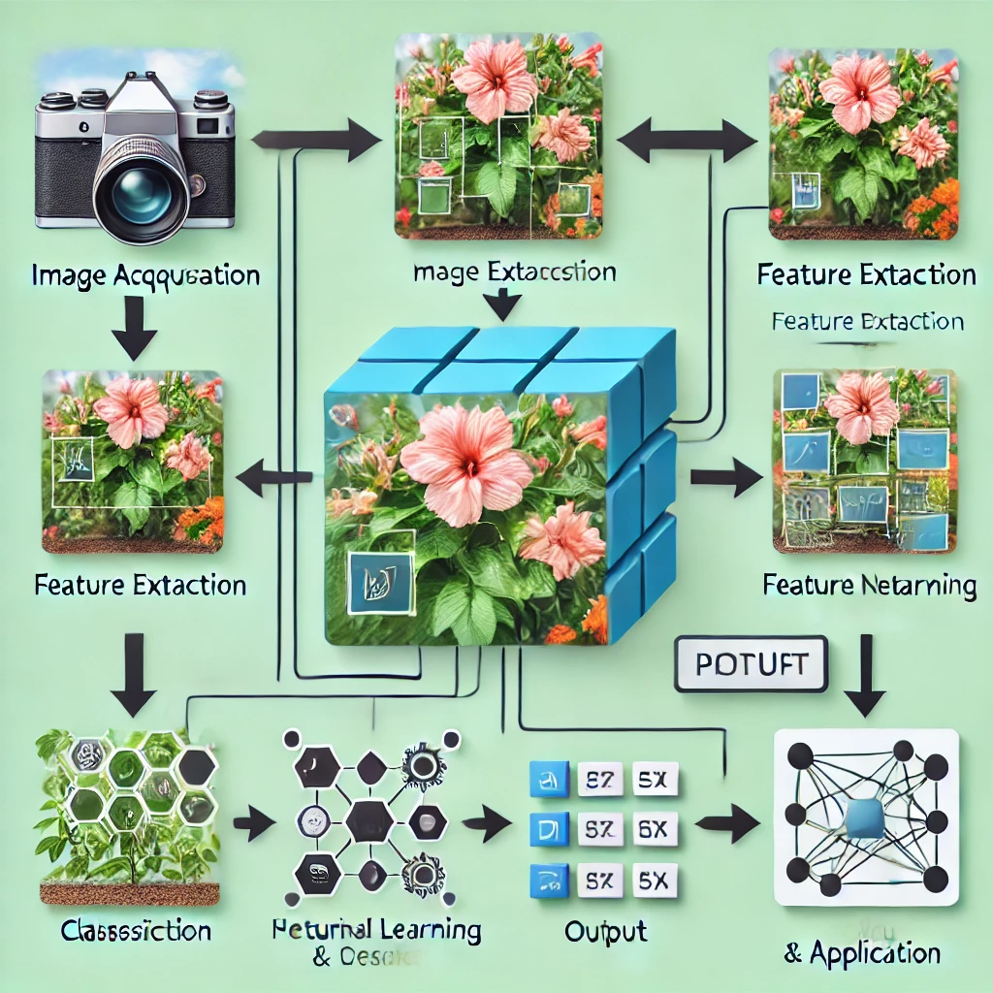
Architecture

Slide 12
Architecture
Architecture Flow:
Image Acquisition
Collect images of medicinal plants/raw materials using cameras or existing datasets.
Preprocessing
Noise removal, resizing, contrast enhancement, and normalization.
Feature Extraction
Extract features like color, texture, shape, and edge detection using image processing techniques.
Machine Learning Model
Train a model using supervised learning techniques like CNN (Convolutional Neural Networks), SVM (Support Vector Machine), or Random Forest.
Classification & Prediction
Identify the plant or raw material based on trained data.
Output & Application
Display the identified plant with details such as scientific name, medicinal properties, and uses.

Slide 13
Hardware components
High-Resolution Camera/Smartphone:
To capture detailed images of medicinal plants for the dataset.
Computer/Laptop:
A powerful computer with a good CPU and ample RAM for processing and training machine learning models.
Suggested Specs: Intel i7/i9 or AMD Ryzen 7/9, 16GB or more RAM, dedicated GPU (e.g., NVIDIA GTX/RTX).
Graphics Processing Unit (GPU):
A dedicated GPU to accelerate deep learning model training and image processing tasks.
Suggested: NVIDIA GeForce RTX series or similar.
Storage Device:
Sufficient storage for dataset, preprocessed images, and model checkpoints.
Suggested: 1TB SSD or more.
External Storage/Cloud Storage:
Backup and storage of large datasets and model backups.
Options: External HDD/SSD, or cloud services like AWS S3, Google Cloud Storage.

Slide 14
Software components
Operating System:
Preferred: Windows 10/11, macOS, or Linux (Ubuntu).
Programming Languages:
Primary: Python (for machine learning and image processing tasks).
Integrated Development Environment (IDE):
Suggested: Jupyter Notebook, PyCharm, or VSCode.
Libraries and Frameworks:
Image Processing: OpenCV, PIL (Pillow), scikit-image.
Machine Learning: TensorFlow, Keras, PyTorch, scikit-learn.
Data Manipulation: NumPy, pandas.
Visualization: Matplotlib, Seaborn.
Deep Learning Models:
Convolutional Neural Networks (CNN): Pre-trained models like VGG, ResNet, or custom CNN architectures.
Transfer Learning: Frameworks like TensorFlow Hub or PyTorch Hub.

Slide 15
Software components (cont..)
7.User Interface Development:
Web Development: HTML, CSS, JavaScript, Flask/Django for web application.
Mobile Development (Optional): React Native, Flutter.
8.Version Control System:
To manage codebase and collaborate with team members.
Suggested: Git, GitHub.
9.Cloud Services (Optional):
For model training, deployment, and storage.
Options: AWS, Google Cloud Platform, Microsoft Azure.
10.Documentation Tools:
Tools to document the project, code, and findings.
Suggested: Sphinx, MkDocs, Jupyter Notebook for interactive documentation
11. Database Management System:
For storing image metadata and user feedback.
Suggested: SQLite, MySQL, or PostgreSQL.

Slide 16
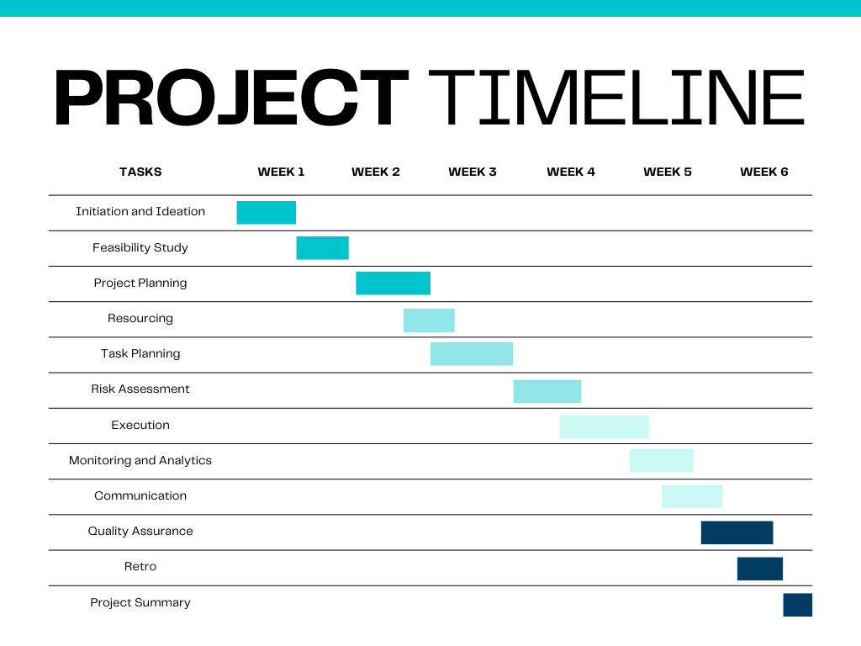
Timeline of Project

Slide 17
Expected Outcomes
1. Accurate Identification:
A machine learning-based system capable of correctly classifying medicinal plants and raw materials with high precision.
2. Automation & Efficiency :
Reduced reliance on manual identification, making the process faster, scalable, and less error-prone.
3. Feature Extraction:
Effective recognition of plants using key features like leaf shape, texture, and color for classification.
4. User-Friendly Application:
A practical tool that can be used by researchers, herbalists, and pharmaceutical industries for real-time plant identification.
.

Slide 18
Conclusion
The identification of medicinal plants and raw materials using image processing and machine learning offers a fast, accurate, and automated solution.
By leveraging feature extraction techniques and advanced classification models, the system ensures high accuracy and scalability.
The implementation of this technology can benefit researchers, herbalists, and the pharmaceutical industry, facilitating better utilization of medicinal plants.
Future improvements can focus on enhancing model performance, expanding datasets, and integrating real-time applications for broader usability.
This approach eliminates human errors and overcomes the limitations of traditional methods, making plant identification more efficient and accessible.

Slide 19
Github Link
Github Link
https://github.com/Sreyya777/PIP2001_CAPESTONE-PROJECT

Slide 20
References
S. Patel et al., "Automated Medicinal Plant Identification through Image Processing and Machine Learning," IEEE Access, 2023.
R. Kumar and V. Sharma, "Medicinal Plants Recognition Using Deep Learning," IEEE Transactions on Computational Biology, 2022.
M. Jadhav et al., "Plant Identification Using Machine Learning," IEEE Conference on Smart Technologies, 2021.
A. Gupta et al., "Medicinal Plant Classification Using Transfer Learning and Traditional Methods," IEEE INDIACom, 2020.
P. Rao et al., "Real-Time Identification of Medicinal Plants Using Machine Learning," IEEE International Conference on AI and IoT, 2023.

Slide 21
Reference
6. T. Banerjee and S. Roy, "Plant Identification and Analysis of Medicinal Properties Using Image Processing and Machine Learning," IEEE Xplore, 2021.
7. N. Singh et al., "Medicinal Plants Attribute Detection by Deep Learning Image Processing Techniques," IEEE Transactions on Image Processing, 2022.
8. S. Iyer and K. Ramesh, "Medicinal Plant Species Detection Using Deep Learning," IEEE International Symposium on Bioinformatics, 2023.
9. G. Priyanga et al., "Automated Identification of Medicinal Plants Using Machine Learning," International Journal of Creative Research Thoughts (IJCRT), vol. 12, no. 3, pp. i718-i724, March 2024.
10. Abhishek Gokhale et al., "Identification of Medicinal Plant Using Image Processing and Machine Learning," in Applied Computer Vision and Image Processing, Springer, pp. 272–282, July 2020.

Slide 22

Project work mapping with SDG
Mapped SDG Goals:
Goal 3: Good Health and Well-being
Enhances the identification of medicinal plants, contributing to better health and well-being by promoting the use of natural and traditional medicine.
Goal 9: Industry, Innovation, and Infrastructure
Utilizes advanced technologies and promotes innovation in the field of medicinal plant identification, contributing to sustainable industrial development.
Goal 15: Life on Land
Supports the conservation and sustainable use of terrestrial ecosystems by promoting the identification and protection of medicinal plants and biodiversity

Slide 23
Thank You

